Slide 1
IT2050 - Computer Networks
Lecture 3
Routing Protocols
Ms. Hansika Mahaadikara

Slide 2



What Is Routing?
To route, a router needs to do the following:
  Know the destination address.
  Identify the sources it can learn from.
  Discover possible routes.
  Select the best route.
  Maintain and verify routing information.
10.120.2.0
172.16.1.0

Slide 3
What Is Routing? (cont.)
10.120.2.0
172.16.1.0
E0
S0
Network
Protocol
Destination
Network
Exit Interface
Connected
Learned
10.120.2.0
172.16.1.0
E0
S0
Routed Protocol: IP
  Routers must learn destinations that are not directly connected.

Slide 4
Identifying Static & Dynamic Routes
Static Route
  Uses a route that a network administrator enters into the router manually
Dynamic Route
  Uses a route that a network routing protocol adjusts automatically for topology or traffic changes

Slide 5
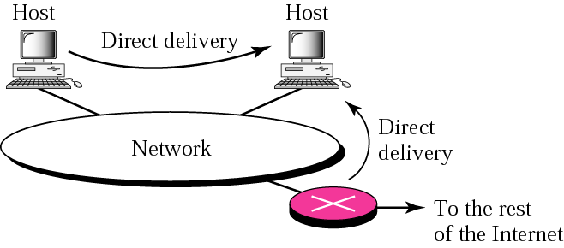
Direct Delivery
Send a message to a machine in the SAME LAN

Slide 6
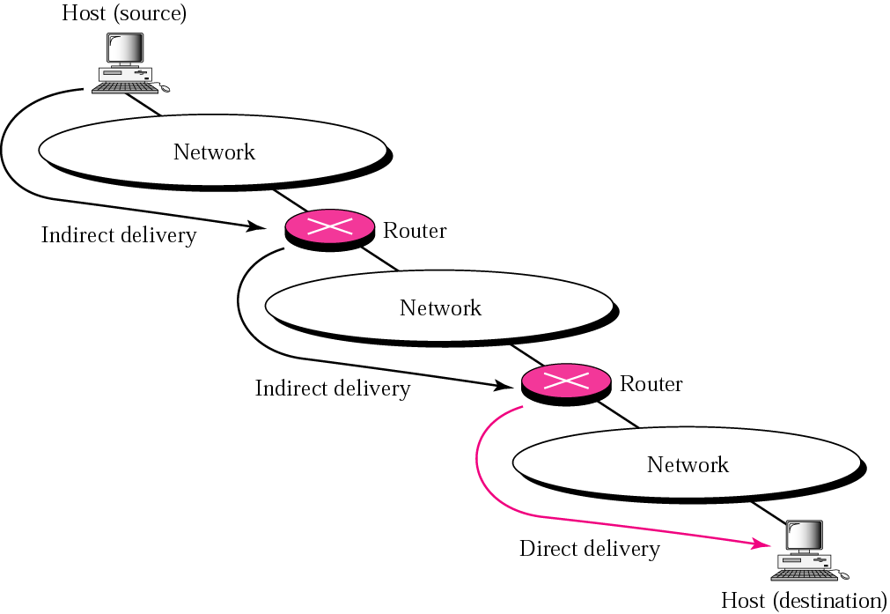
Indirect Delivery

Slide 7
Indirect Delivery cont.
To send a packet from source to destination, need to go to the network
( packet should go from router to router )
All routers should maintain a routing table
IP packet is analyzed at the router and correct path is selected form the routing table
The packet is sent though that path
Indirect delivery is done using the routing strategies

Slide 8
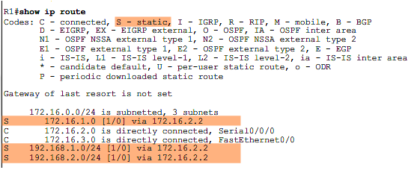
Routing Table

Slide 9
Adaptive Routing
Routing Strategies
There are four routing strategies
  - Fixed Routing
  - Flooding
  - Random Routing
  -

Slide 10
Adaptive Routing
Each router maintains a routing table
Routing table modifies itself according to the network changes
Advantages
- Network traffic is minimized
- Low latency
- The best route will be selected most
Disadvantages
- Router memory need to keep a routing table

Slide 11
Routing Methods used in
Adaptive Routing
Next hop routing
  Host specific
  Network specific
Default routing

Slide 12
Host Specific Routing
Each router keeps one record/entry for each
Table entry has Host IP and the Interface
Host Address | Interface
192.168.50.1 192.168.50.6 | E0 E0
172.18.2.9 | S1
172.18.5.96 | S1
Disadvantages
Large number of records
Table updating is difficult and complex as it should be done for each and every host (if the host IP changes)

Slide 13
Network Specific Routing
Each router keeps a table entry for each network (one record for one network)
Table entry has Network address and Interface
Network Address | Interface
192.168.50.0 | E0
172.18.0.0 | S1
Advantages
Number of records are limited (Table updates are not for each host but for a network)
Update is easy

Slide 14
Routing Table update Methods
Basic methods to update routing tables
- Connected
- Static
- Dynamic

Slide 15
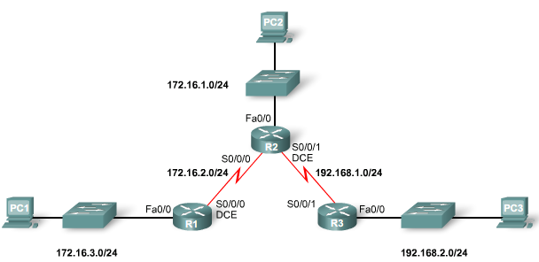
Connected
Once the router is connected to the network its interfaces are given IP addresses
With that router automatically identifies the network addresses to which it connected

Slide 16
Connected cont.
R1#show ip route
Codes: C - connected, S - static,
Gateway of last resort is not set
172.16.0.0/24 is subnetted, 2 subnets
C 172.16.2.0 is directly connected, Serial0/0/0
C 172.16.3.0 is directly connected, FastEthernet0/0

Slide 17
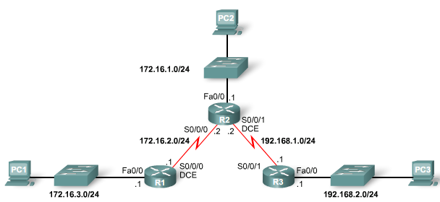
Static
Administrator can manually give routing table records
Router(config)#ip route <destination network>
<destination network subnet mask>
<next hop address | exit interface | Both>

Slide 18
Static cont.
R1(config)#
R1(config)#ip route 172.16.1.0 255.255.255.0 172.16.2.2
R1(config)#ip route 192.168.1.0 255.255.255.0 172.16.2.2
R1(config)#ip route 192.168.2.0 255.255.255.0 172.16.2.2
R1(config)#
R1#show ip route
Codes: C - connected, S - static
Gateway of last resort is not set
172.16.0.0/24 is subnetted, 3 subnets
S 172.16.1.0 [1/0] via 172.16.2.2
C 172.16.2.0 is directly connected, Serial0/0/0
C 172.16.3.0 is directly connected, FastEthernet0/0
S 192.168.1.0/24 [1/0] via 172.16.2.2
S 192.168.2.0/24 [1/0] via 172.16.2.2

Slide 19
Static cont.
Advantages:
Minimal CPU processing
Easier for administrator to understand and configure
Disadvantages:
Configuration and maintenance is time-consuming
Configuration is error-prone
Administrator should maintain changing route information
Does not scale well with growing networks; maintenance becomes complex
Requires complete knowledge of the whole network for proper implementation

Slide 20
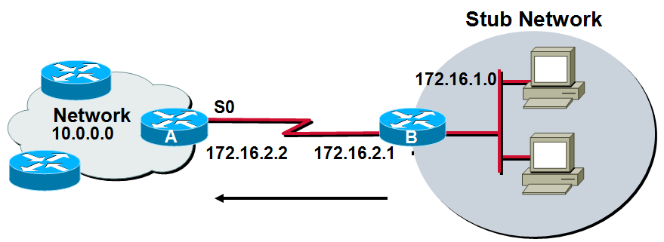
Default Routing
Last record in the routing table
Indicates the route/path to be taken, if any of the records does not match with the IP packet destination IP address
Stub networks only use default routing , Stub networks have only one exit port out of the network
R(config)#ip route 0.0.0.0 0.0.0.0
<next hop ip addr | exit interface name | both>

Slide 21
Default Routing cont.
B(config)#
B(config)#ip route 0.0.0.0 0.0.0.0 172.16.2.2
B(config)#
B#show ip route
Codes: C - connected, S - static
Gateway of last resort is 172.16.2.2 to network 0.0.0.0
172.16.0.0/24 is subnetted, 2 subnets
C 172.16.1.0 is directly connected, FastEthernet0/0
C 172.16.2.0 is directly connected, Serial2/0
S* 0.0.0.0/0 [1/0] via 172.16.2.2
B#

Slide 22
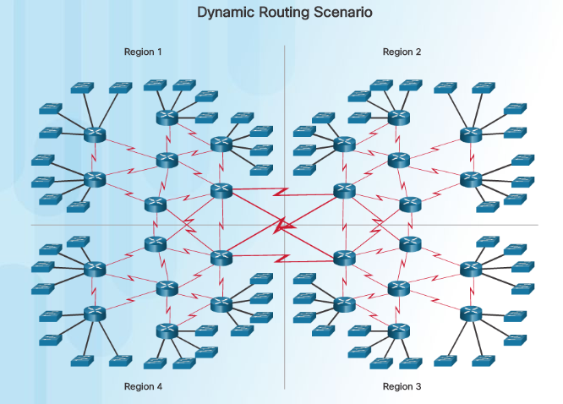
Dynamic Routing Scenario

Slide 23
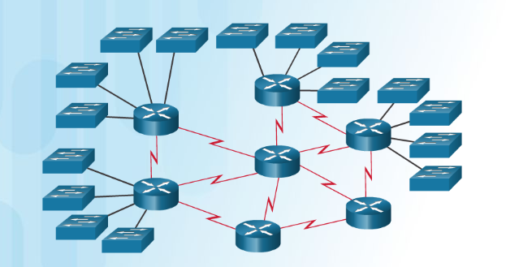
Dynamic Routing Scenario

Slide 24
Dynamic
Routing tables are updated automatically by using routing protocols
Routing tables have
  Initially only connected records
  Then add static’ records
  Then automatic dynamic updates

Slide 25
Dynamic cont.
Advantages:
Administrator has less work maintaining the configuration when adding or deleting networks
Protocols automatically update, according to the topology changes.
Configuration is less error-prone
Suitable for More scalable, growing networks
Disadvantages:
Router resources are used (CPU cycles, memory and bandwidth)
More administrator knowledge is required for configuration, verification, and troubleshooting

Slide 26
Routing Protocols

Slide 27
Features of Routing Protocols
Network changes (addition or removal or fault) are automatically updated in routing tables of all routers
When there are many routes to a destination, the best route should be selected
Share the traffic through different routes

Slide 28
What Is a Routing Protocol?
  Routing Protocols allow routers to dynamically advertise and learn routes, determine which routes are available and which are the most efficient routes to a destination
10.120.2.0
172.16.1.0
E0
S0
Network
Protocol
Destination
Network
Exit Interface
172.17.3.0
Connected
RIP
EIGRP
10.120.2.0
172.16.2.0
172.17.3.0
E0
S0
S1
Routing Protocol: RIP, EIGRP,OSPF

Slide 29
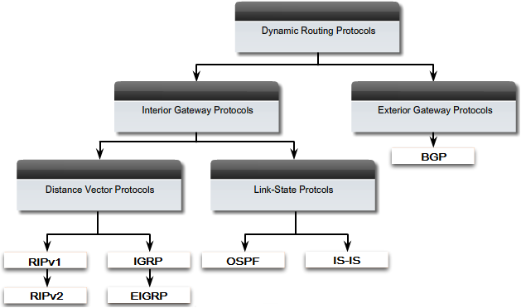
Routing Protocols

Slide 30
Routing Protocols cont.
An autonomous system (AS) is a collection of routers under a common administration
ex : a company's internal network
Interior Gateway Protocols (IGP) are used for
intra-autonomous system routing
(routing inside an autonomous system)
Exterior Gateway Protocols (EGP) are used for
inter-autonomous system routing
(routing between autonomous systems)

Slide 31
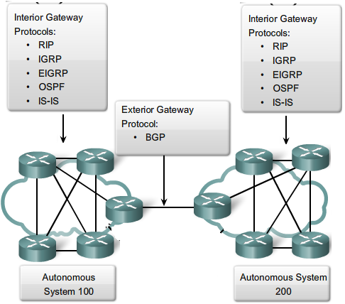
Routing Protocols cont.

Slide 32
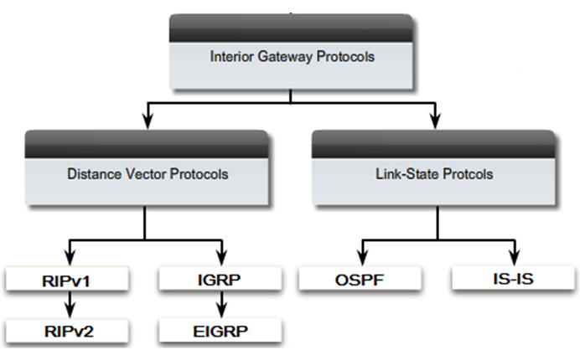
Interior Gateway Protocols (IGP)

Slide 33
RIP
(Routing Information Protocol)

Slide 34
RIP (Routing Information Protocol)
A Distance-vector routing protocol
It sends the complete routing table out to all active interfaces in every 30 seconds
Only uses hop count to select best way to a remote network
RIP works well in small networks, but it is inefficient on large networks
There are two versions
RIP v1, RIP v2

Slide 35
RIP Configuration
Router(config)#router rip
Router(config-router)#network <network-address>
< network-address>
Directly connected network addresses

Slide 36

RIP Configuration Example
Version 1
E0
S0
S1
S0
S1
E0
172.16.0.0
A
B
C
192.168.1.0
172.16.0.1
10.0.0.1
10.0.0.2
11.0.0.1
11.0.0.2
192.168.1.1
router rip
network 172.16.0.0
network 10.0.0.0
router rip
network 192.168.1.0
network 11.0.0.0
2.3.0.0
2.3.0.0
router rip
network 10.0.0.0
Network 11.0.0.0

Slide 37
Configure RIP V2
Classless
Sub-networks
Router(config)#router rip
Router(config)#version 2
Router(config-router)#network <network-address>
< network-address> : Directly connected sub-network addresses

Slide 38
RIP Configuration Example
Version 2
E0
S0
S1
S0
S1
E0
172.16.64.0
A
B
C
192.168.1.128
172.16.64.1
10.0.1.1
10.0.1.2
10.0.2.1
10.0.2.2
192.168.1.129
router rip
Version 2
No auto-summary
network 172.16.64.0
network 10.0.1.0
router rip
Version 2
No auto-summary
network 192.168.1.0
network 10.0.2.0
2.3.0.0
2.3.0.0
router rip
Version 2
No auto-summary
network 10.0.1.0
Network 10.0.2.0

Slide 39
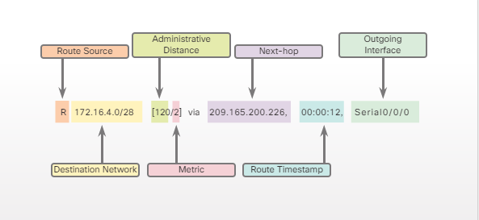

Slide 40
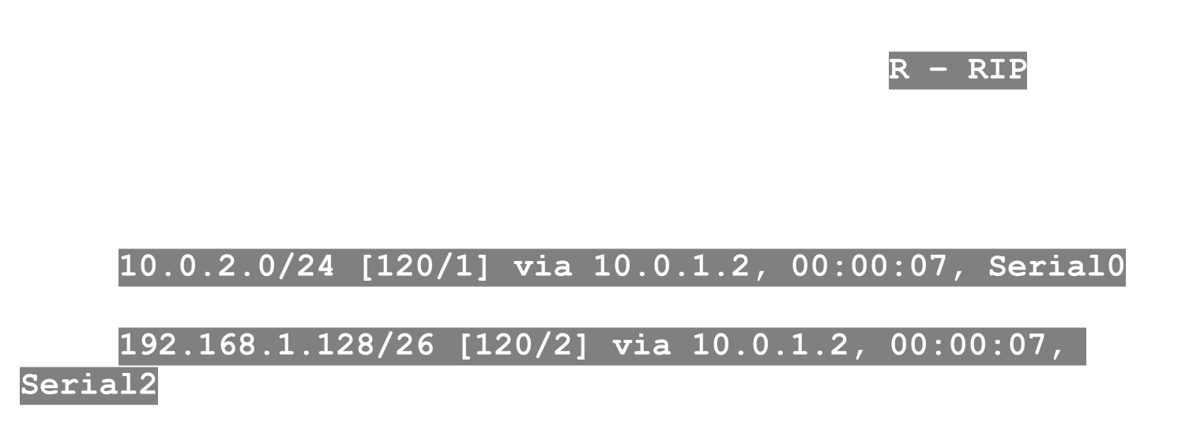
Displaying the IP Routing Table
10.0.1.2
E0
S0
S1
S0
S1
E0
172.16.64.0
A
B
C
192.168.1.128
10.0.1.0
10.0.2.0

Slide 41
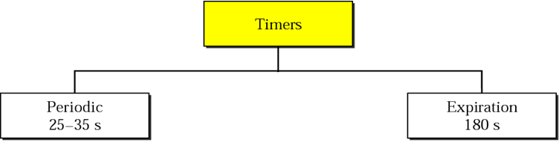
RIP Timers
Periodic Timer
  A timer kept at each router for sending its routing table information to its neighbors in every 30 seconds.
Expiration Timer
- If a router does not get the updates from a neighboring router for a long time ,( means it is a problem with the neighboring router) the main router removes the updates got from that neighboring router
- Is called expiration time ( 180 seconds )

Slide 42
Problems with RIP
Slow Convergence
Routing tables are sent to neighbors every 30 seconds
When there are large number of routers in the network ,it will take some time to get all the details to each and every router .There is a delay in getting an updated routing table.
Solution
Triggered updates
  Information that needed to be updated immediately is informed to the other routers without waiting for the periodic time.

Slide 43
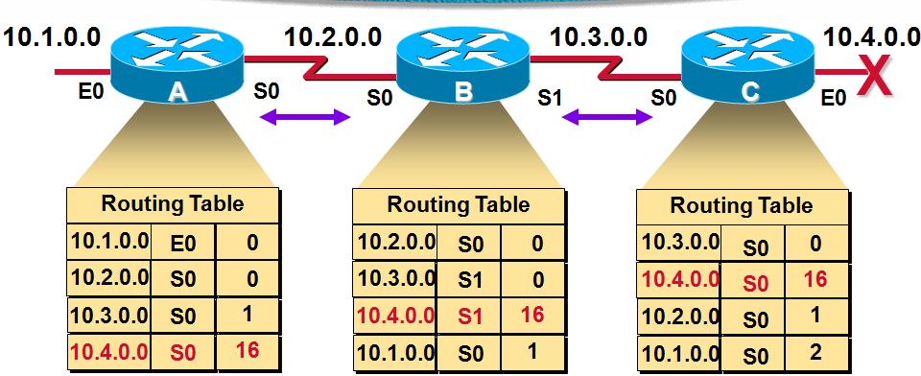
Counting to infinity
Solution - Route Poisoning
When a network goes down the router that is connected to that network will get that information first
So that router updates its table saying this network is down (unreachable )
In the routing table it says number of hops for that particular network as infinity (or in RIP as 16)

Slide 44
Instability
Once a router (P) get some updates from other router (Q) router P will updates it routing table and new routing table sent again to previous router.
With time this will lead to having wrong updated tables in the routers and ultimately to an unstable situation
Solution
  Spilt Horizon - Do not send same information via the
  link which that information came from

Slide 45
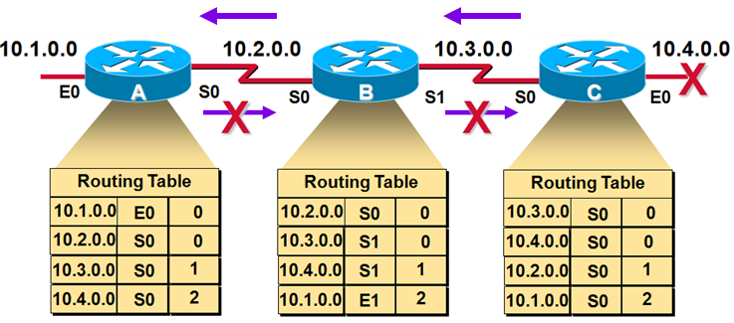
Solutions
Split Horizon
When the router sends routing table information to the neighbors, it will not send the information that it got from that particular router
So the routing table information will be selected and send

Slide 46
Hold down Timer
Once a network goes down, that information will be immediately sent to the other routers
Because of the network connections there is a possibility to get some wrong information about that particular network from other routers
Therefore once a network down information is received, the router will start the hold down timer, during which time any updates regarding that particular network is ignored.

Slide 47
Poison Reverse
In general split horizon will apply for information passing
But the split horizon will not be applied in the case of the information like network is down

Slide 48
IGRP AD - 100
(Interior Gateway Routing Protocol )
A cisco proprietary distance-vector routing protocol
Maximum hop count is 255
Used in large networks
EIGRP is the enhanced version of IGRP

Slide 49
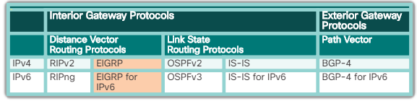
EIGRP

Slide 50
EIGRP
(Extended Interior Gateway Routing Protocol )

Slide 51
Features
EIGRP was initially released in 1992 as a proprietary protocol available only on Cisco devices.
In 2013, Cisco released a basic functionality of EIGRP as an open standard to the IETF as an informational RFC.
Other networking vendors can now implement EIGRP on their equipment to interoperate with both Cisco and non-Cisco routers running EIGRP.

Slide 52
EIGRP Metric AD - 90
A ‘ Composite metric ‘ is used
EIGRP uses bandwidth and delay of the line by default as a metric for determining the best route to an internetwork
Metric is a combination of bandwidth, delay of the line , Reliability, load and Maximum Transmission Unit (MTU)
Reliability, load, and Maximum Transmission Unit (MTU) are not used by default

Slide 53
EIGRP metric values
Bandwidth - The slowest bandwidth among all of the outgoing interfaces, along the path from source to destination.
Delay - The cumulative (sum) of all interface delay along the path (in microseconds).

Slide 54
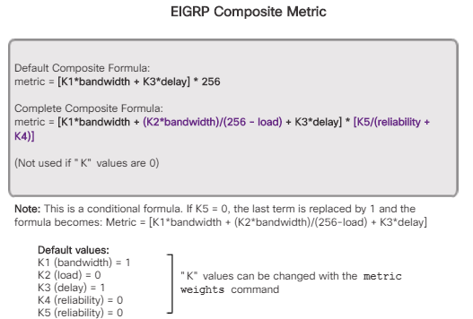

Slide 55
EIGRP Configuration
Router(config)#router Eigrp <AS number>
Router(config-router)#network <network-address>
< network address > : Directly connected network addresses
< AS number > : Autonomous Systems Number

Slide 56
EIGRP Configuration Example
E0
S0
S1
S0
S1
E0
172.16.64.0
A
B
C
192.168.1.128
172.16.64.1
10.0.1.1
10.0.1.2
10.0.2.1
10.0.2.2
192.168.1.129
router eigrp 100
network 172.16.64.0
network 10.0.1.0
router eigrp 100
network 192.168.1.0
network 10.0.2.0
2.3.0.0
2.3.0.0
router eigrp 100
network 10.0.1.0
Network 10.0.2.0

